Slide 1
1 Planed
Planed 1
Solve the problems left last week.
4

Slide 2
1 Results
Results 1
Solve the all problems left last week.
4

Slide 3
Problems
There are some problems left last week
4

Slide 4
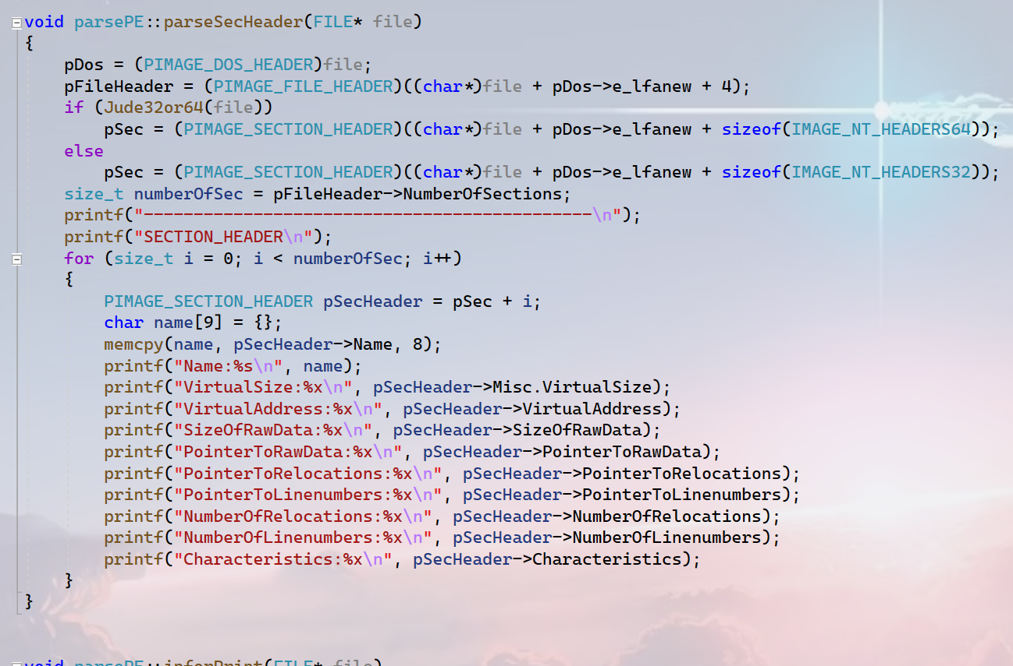
Problems
1
I merge the functions ‘parseSecHeader32’ and ‘parseSecHeader64’ into one function ‘parseSecHeader’ and implements the same features.
4

Slide 5
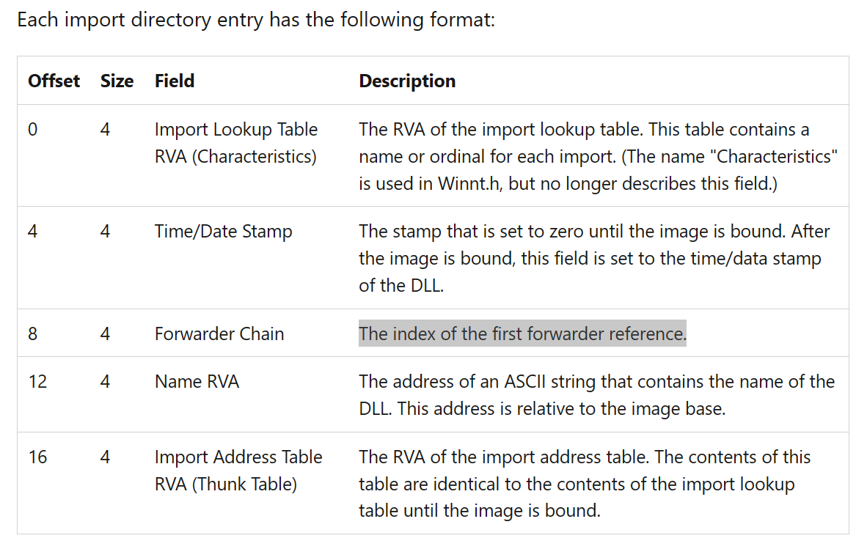

Problems
1
I wanted to look up the details about ‘Forwarder Chain’ online, but failed.
The most important question!!!!!!!!!!I need to pay attention to it.
dll2
dll1
RVA
dll3
dll4
The array of the actual address of the functions.
exe
4

Slide 6
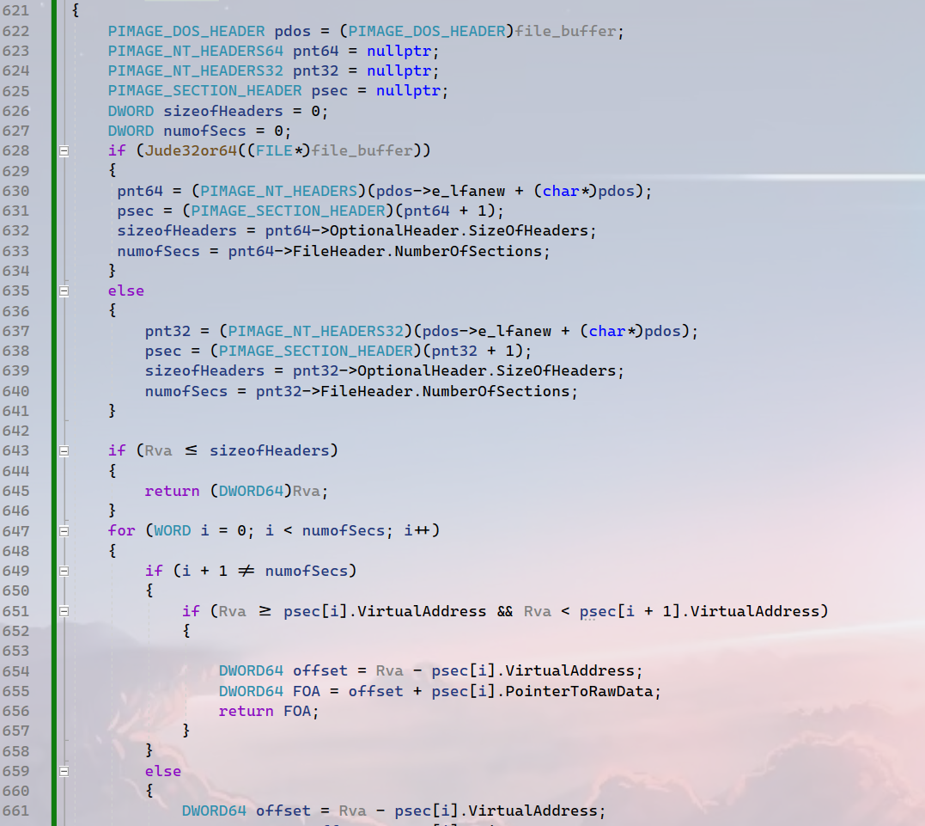
Problems
1
Merge two functions ‘RVATOFOA32’ and ‘RVATOFOA64’ into ‘RVATOFOA’, and implements the same features.
4

Slide 7
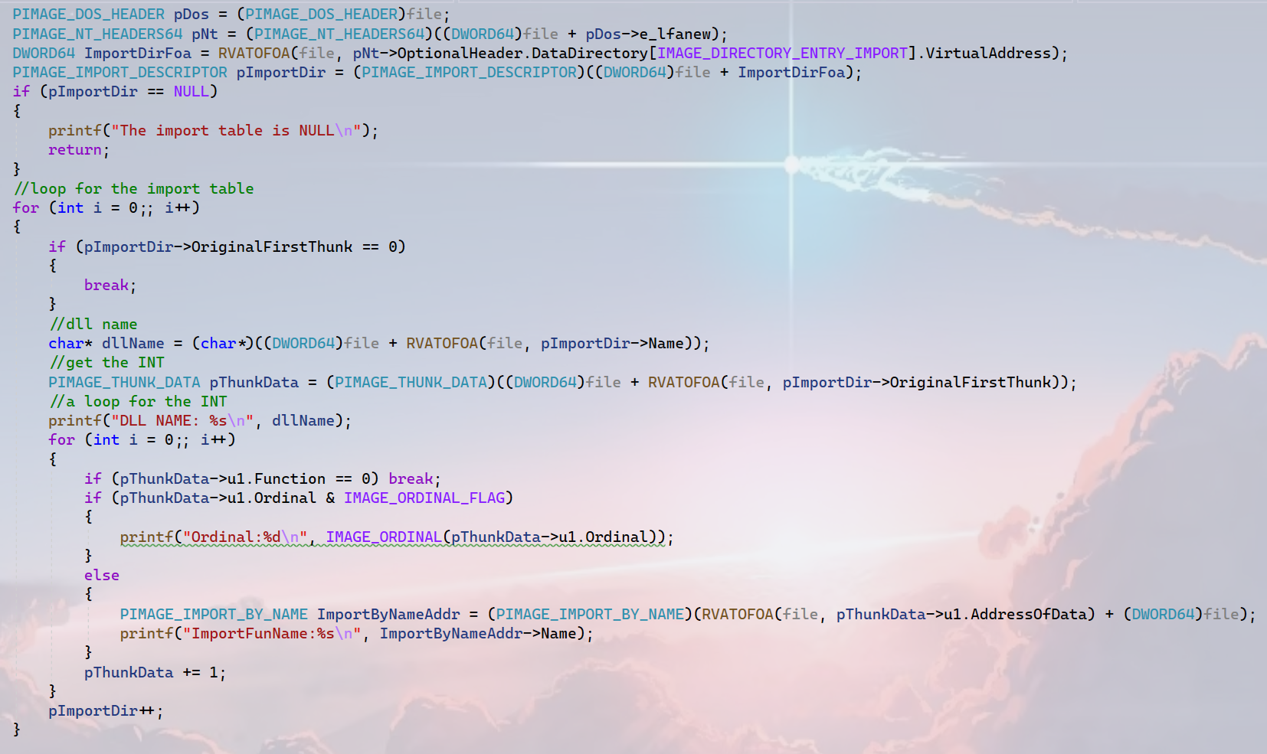
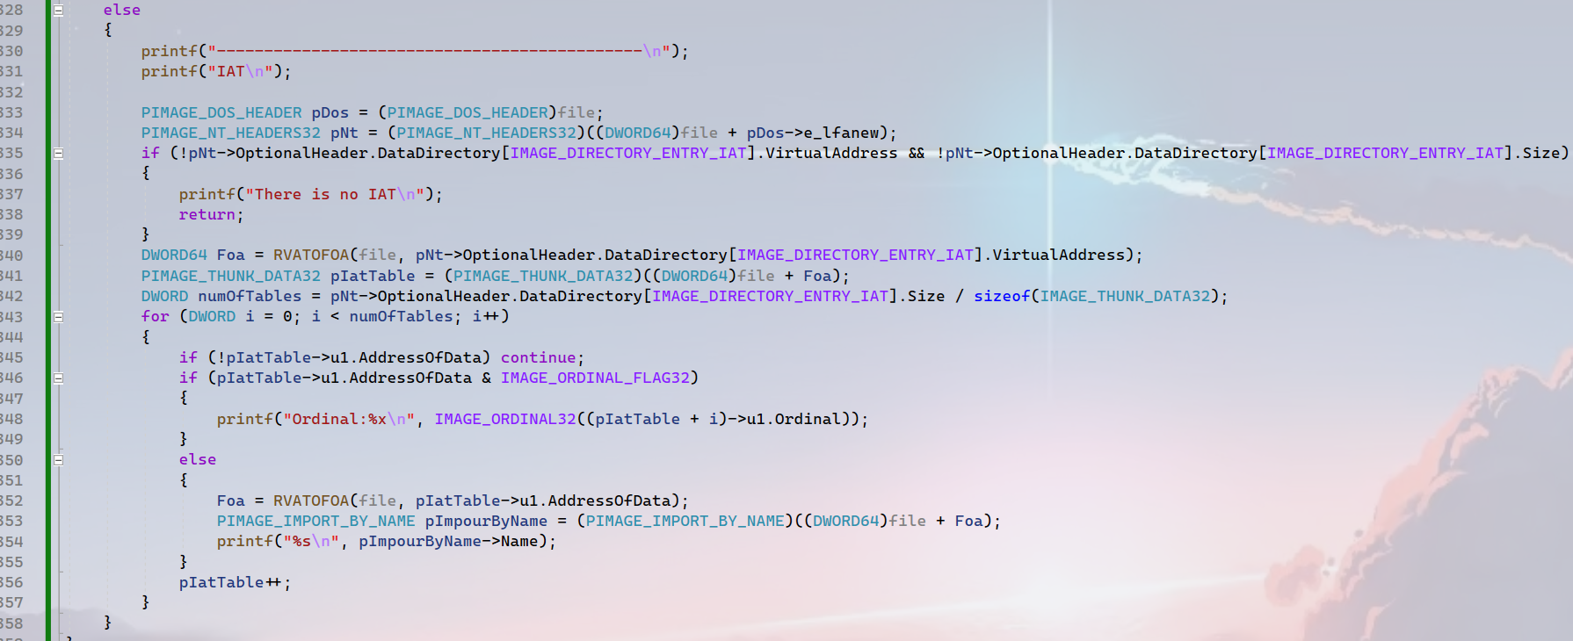
Programs
1
The last meeting, I found that I have parsed the two structures ‘IMAGE_THUNK_DATA32’ and ÍMIAGE_THUNK_DATA64’ , but I just showed you one screenshot……
4

Slide 8



Problems
START
IMAGE_BOUND_IMPORT_DESCRIPTOR
1
IMAGE_BOUND_FORWARDER_REF
The structure of the bound import table.
Each ‘IMAGE_BOUND_IMPORT_DESCRIPTOR’ means a dll that bounded directly. And each ‘IMAGE_BOUND_FORWARDER_REF’ stored the information of the dll that used by the bounded dll.
IMAGE_BOUND_FORWARDER_REF
00000000000000000000000000000
IMAGE_BOUND_IMPORT_DESCRIPTOR
IMAGE_BOUND_IMPORT_DESCRIPTOR
IMAGE_BOUND_FORWARDER_REF
IMAGE_BOUND_IMPORT_DESCRIPTOR
IMAGE_BOUND_FORWARDER_REF
00000000000000000000000000000
TimeDateStamp
TimeDateStamp
IMAGE_BOUND_IMPORT_DESCRIPTOR
NumberOfModuleForwarderRefs
OffsetModuleName
END
00000000000000000000000000000
Reserved
OffsetModuleName
4

Slide 9
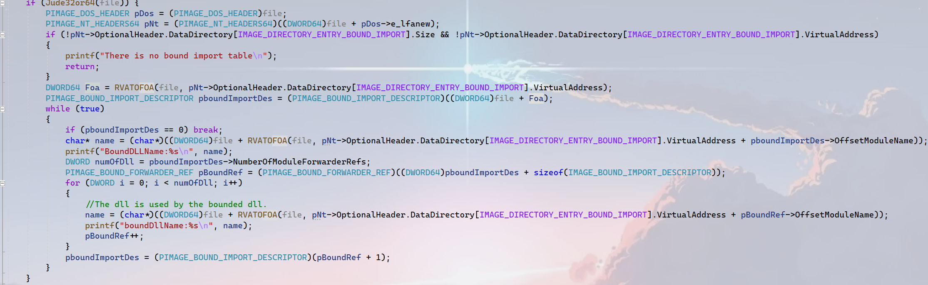
Problems
1
Parse the bound import table, the function has problems before,
4

Slide 10
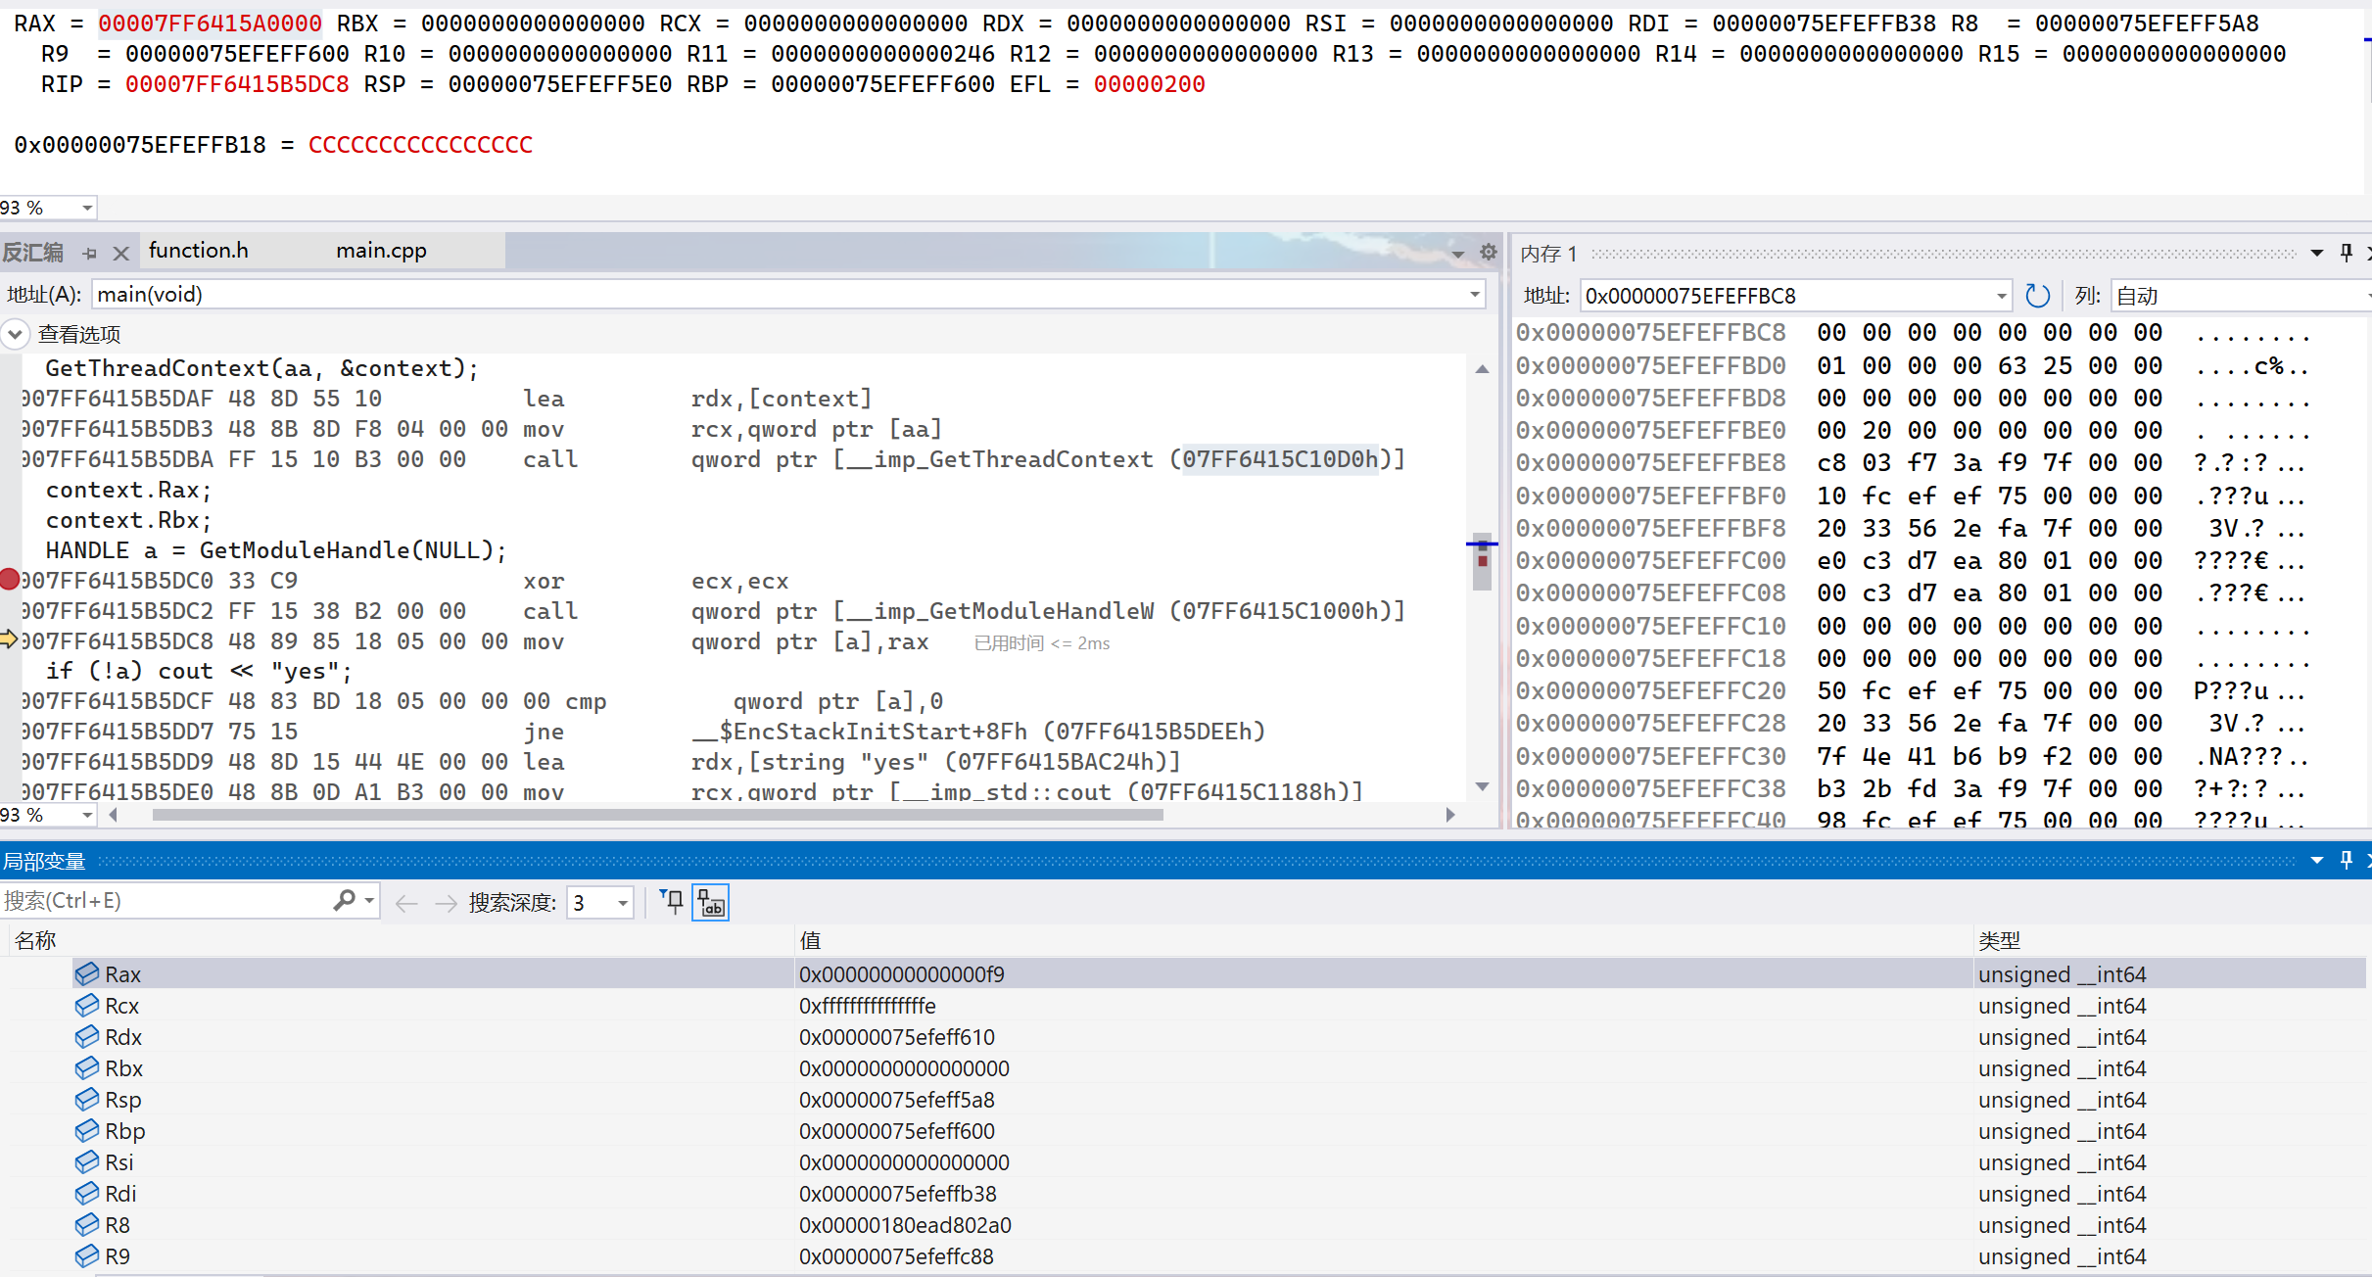
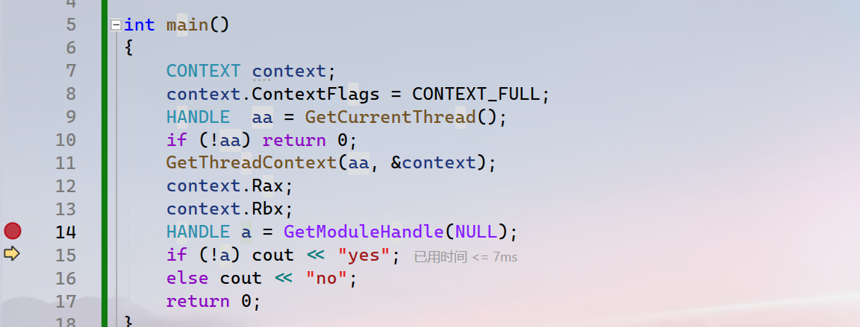
Problems
1
The code is used for my test to find where the imagebase and oep of a process stores.
I want to look for them in the context of current thread, But failed!!!
4

Slide 11
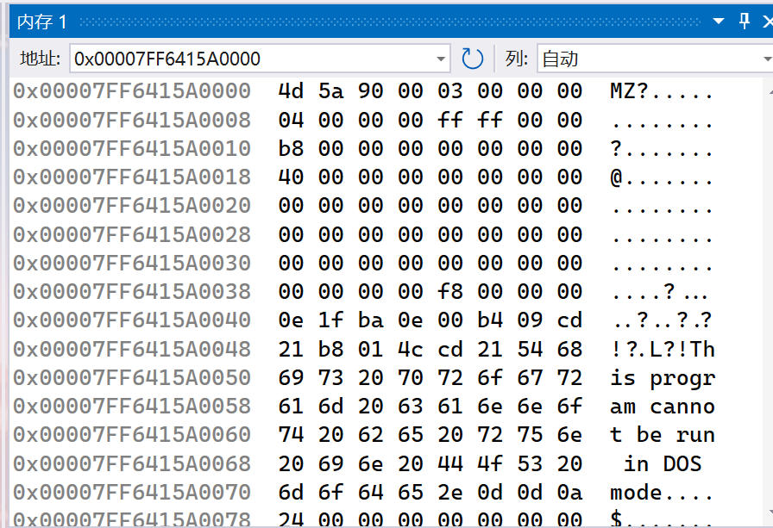
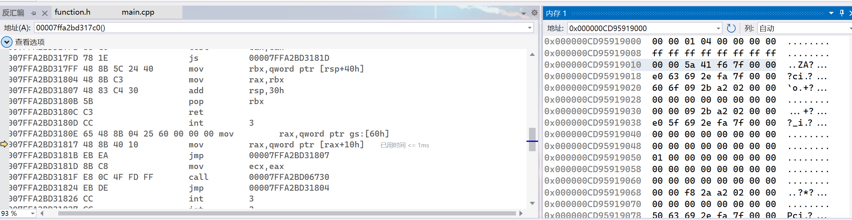
Problems
1
This is how the api ‘GetModuleHandle’ works. I guess the gs:[60] pointer a structure maybe it is PEB. And the [rax + 10h] is the imagebase of the current process.
What is the I think it points to PEB
gs:[60h]?
4

Slide 12
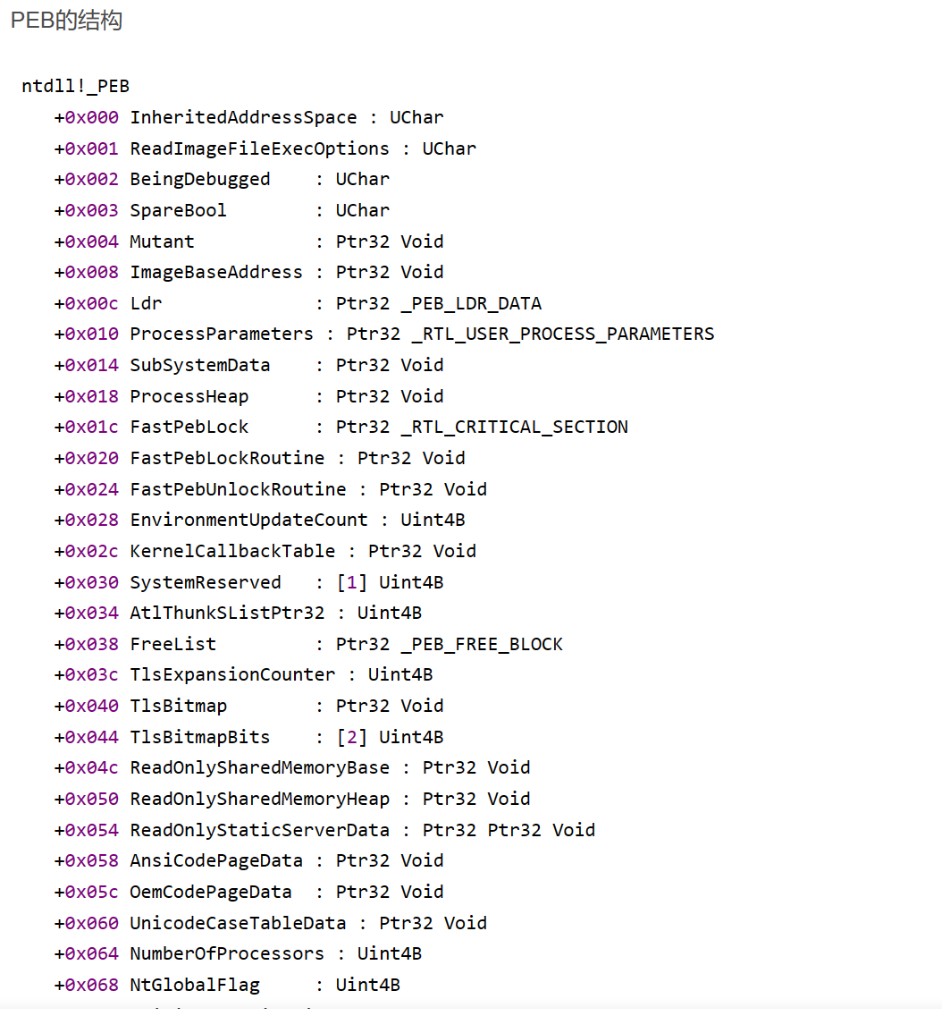
Problems
1
[addr of PEB + 0x8] is the ImageBaseAddress. But it is ptr32! Not 64 and I do not find the 64-bits structure.
4

Slide 13
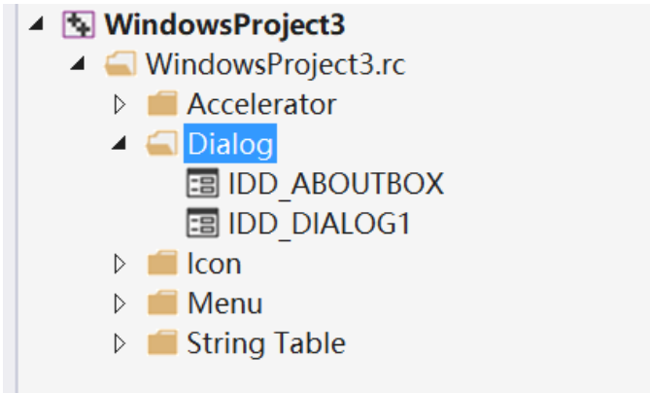
Programs
1
I know that the resource table is like the directory. Please look at the screenshot, It has three floors, WindowsProject3.rc to Dialog to IDD_ABOUTBOX, so the most important part is the third floor.
4

Slide 14
Problems
1
I write two functions bfs and dfs to parse the resource table.
4

Slide 15
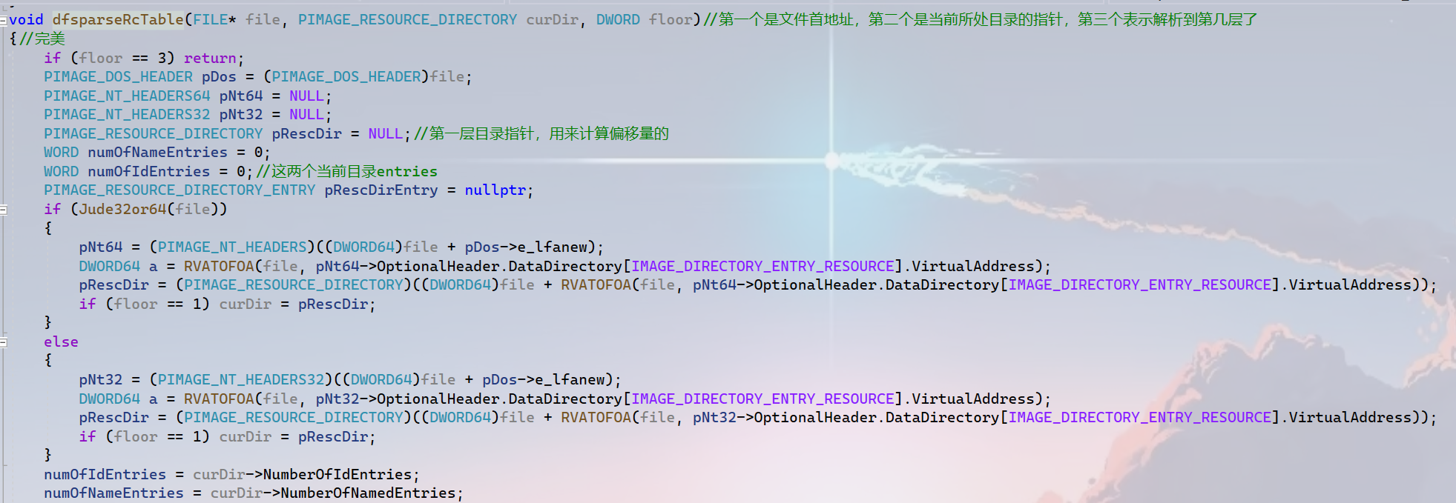
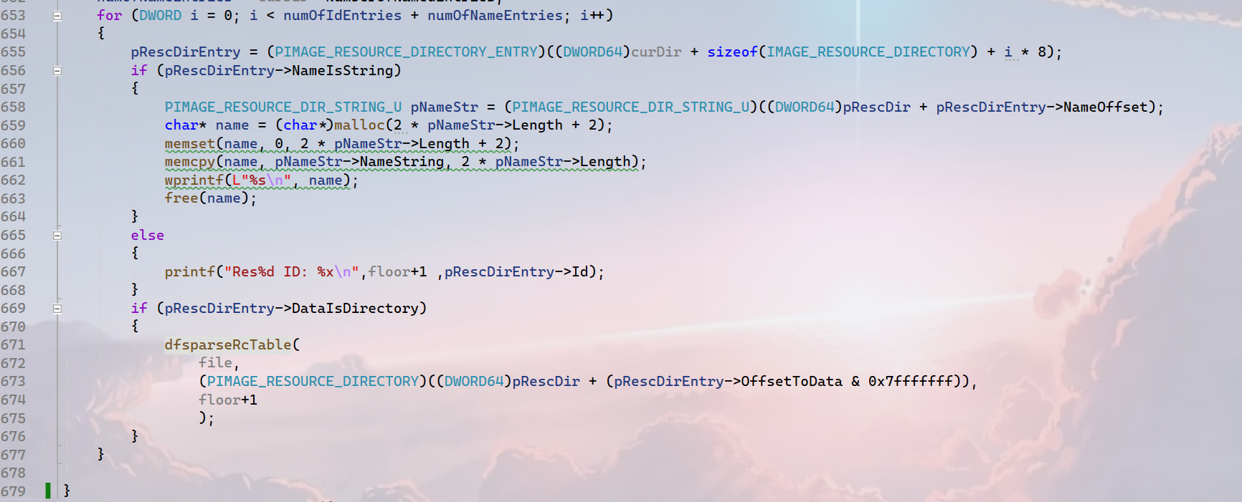
Problems
4

Slide 16
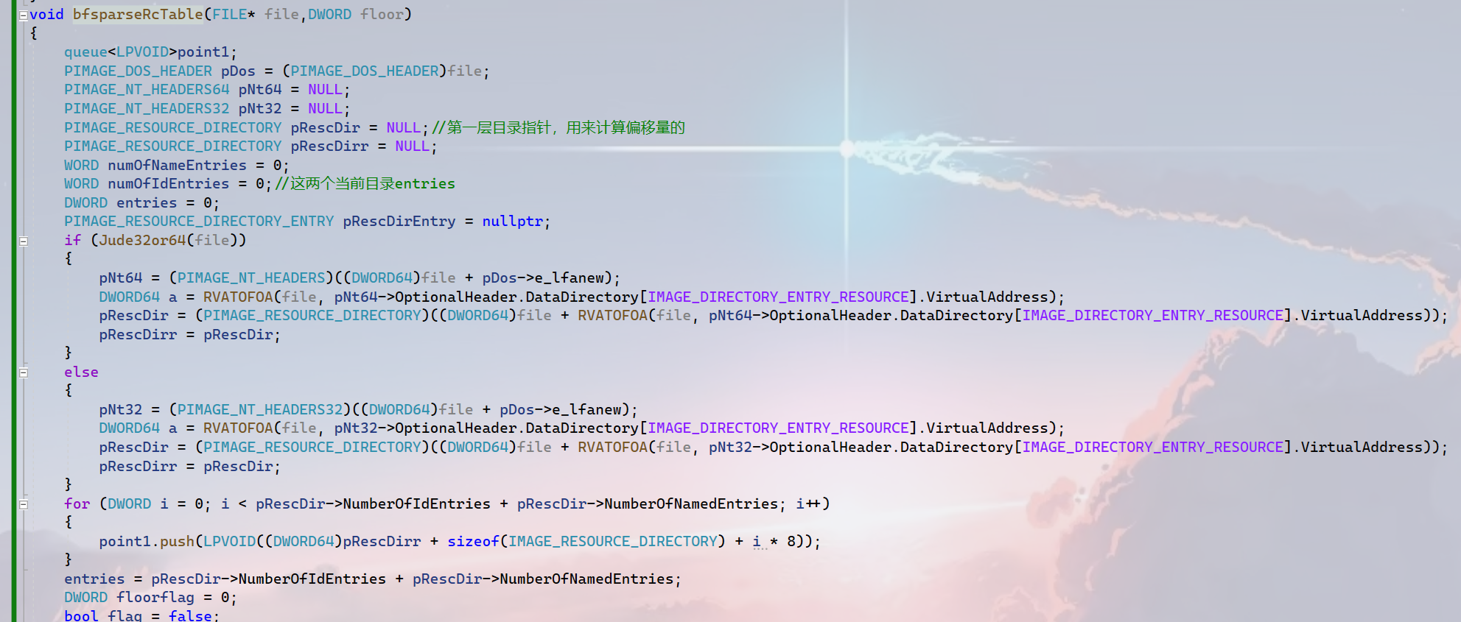
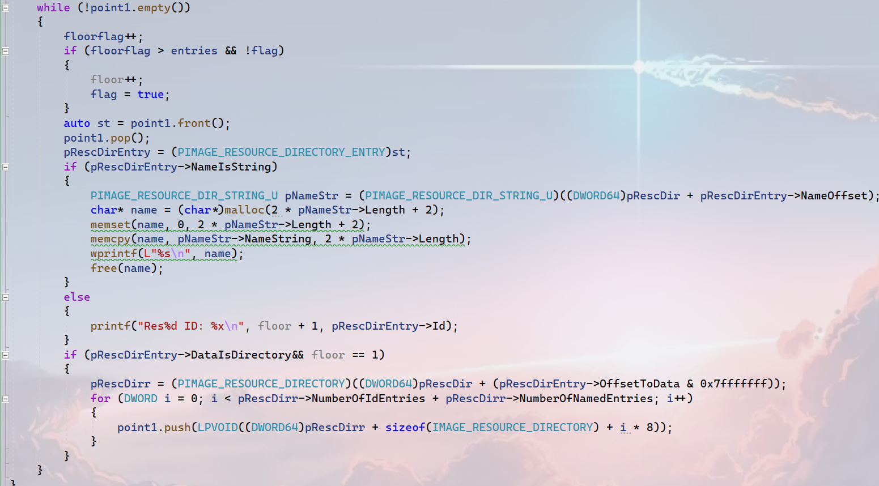
Problems
4

Slide 17
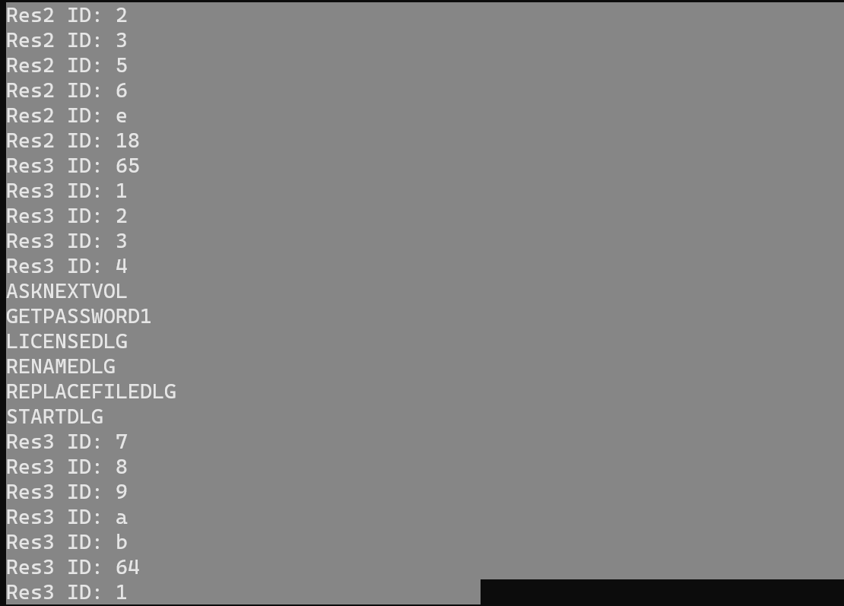
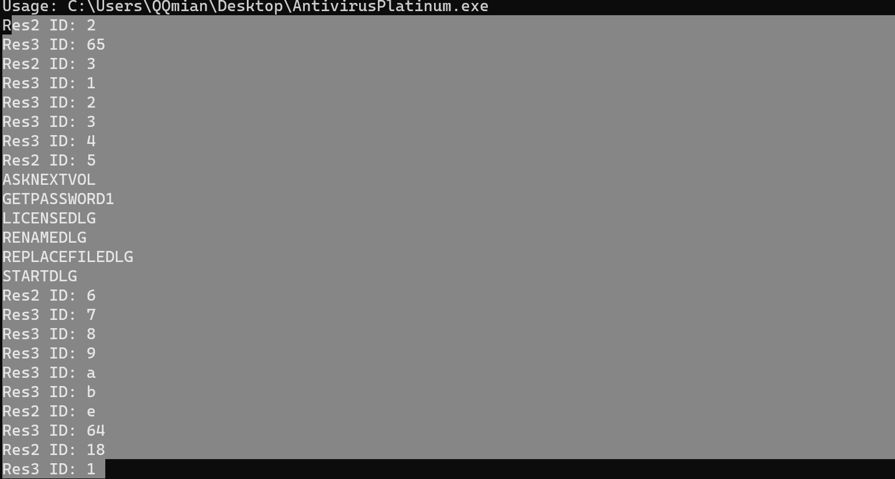
Problems
1
I write two functions bfs and dfs to parse the resource table.
4

Slide 18
1 Plan
plan 1
Solve these problems and start to finish asignment1.
4

